Slide 1
Week 13 Scribing Notes
By: Jack DiPietro, Ben Morgan, Jack Woodburn, Patrick Ryan

Slide 2
A Case Study on Homelessness Services (Paper)
Analyzing the increasing number of homeless people which is affecting the homeless system
5 types of housing
Emergency Shelter
Transitional Housing
Rapid Rehousing
Homelessness prevention
Permanent supportive Housing
Question: Can we improve this system using AI?

Slide 3
What to Keep in Mind
Fairness: through different biases and discrimination
Interpretability
Ethics
Causal Inference: Need counterfactual estimates of different interventions before you can let ML Model decide
Question to look at: How much can we potentially improve outcomes?

Slide 4
Kind of Data
Household Characteristics (Feature)
Which of the 5 services was assigned to them (Feature)
Predictor -> Whether they re-enter the Homeless system within 2 years of exit (Label) (Is this a good metric?) (Looking at 2 years)

Slide 5
Approach
Clean this data to create a dataset
Train an ML model on this that supports causal inference
BART (Bayesian Additive Regression Trees)
Provides counterfactual estimates for re-entry under different services
See if ML model is a good approximation of the real dataset
Use the output of this ML model in an optimization problem which they can solve to find an “improved assignment”

Slide 6
Results
Ground Truth (from their dataset) -> 43.04% households re-enter
Prediction from BART model -> 43.72% households re-enter
Fairly accurate - proved in paper
Optimize
After Optimization of Assignments -> 31.88% households re-enter
Reduction by 27.88%
After Fairness Constraint -> 37.38% people re-enter

Slide 7
Using ML to Assess the Risk and Prevention of Water Main Breaks (Paper)
ML system used in Syracuse NY
Syracuse has a major problem of water main breaks affecting water supply for its residents
The city has an old infrastructure that has created small and large breaks
Paper discusses ML model to predict breaks in the city to focus on locating and fixing them before they break

Slide 8
Plan and Result
Frame it as a binary classification problem of whether a water main break will occur in a given city block within the next 3 years
Result: Precision of 62% in the top 1% of our predictions
Two ways in which system can be used:
1) for preventative maintenance on the top 1% of the riskiest breaks
2) To use the risk scores to coordinate with the Department of Public Works(DPW)

Slide 9
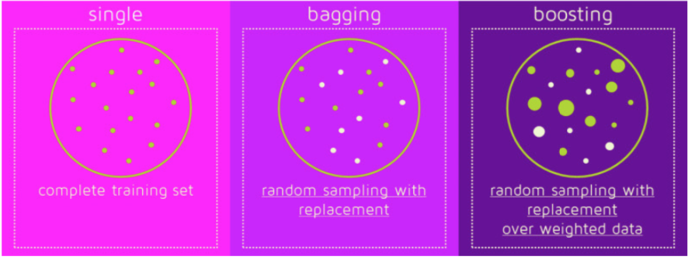
Bagging vs Boosting
Bagging
Stands for Bootstrap Aggregation
Useful for models with high variance and noisy data
Takes original data set D with N training examples and creates M copies
Boosting
Take a week learning algorithm and make it into a very strong one
Becomes better by focusing on difficult cases
Basic steps for most Boosting Algorithms
Train a weak model on some training data
Compute the error of the model on each training example
Give higher importance to examples on which the model made mistakes
Re-train the model using “importance weight” training examples
Go back to step 2

Slide 10
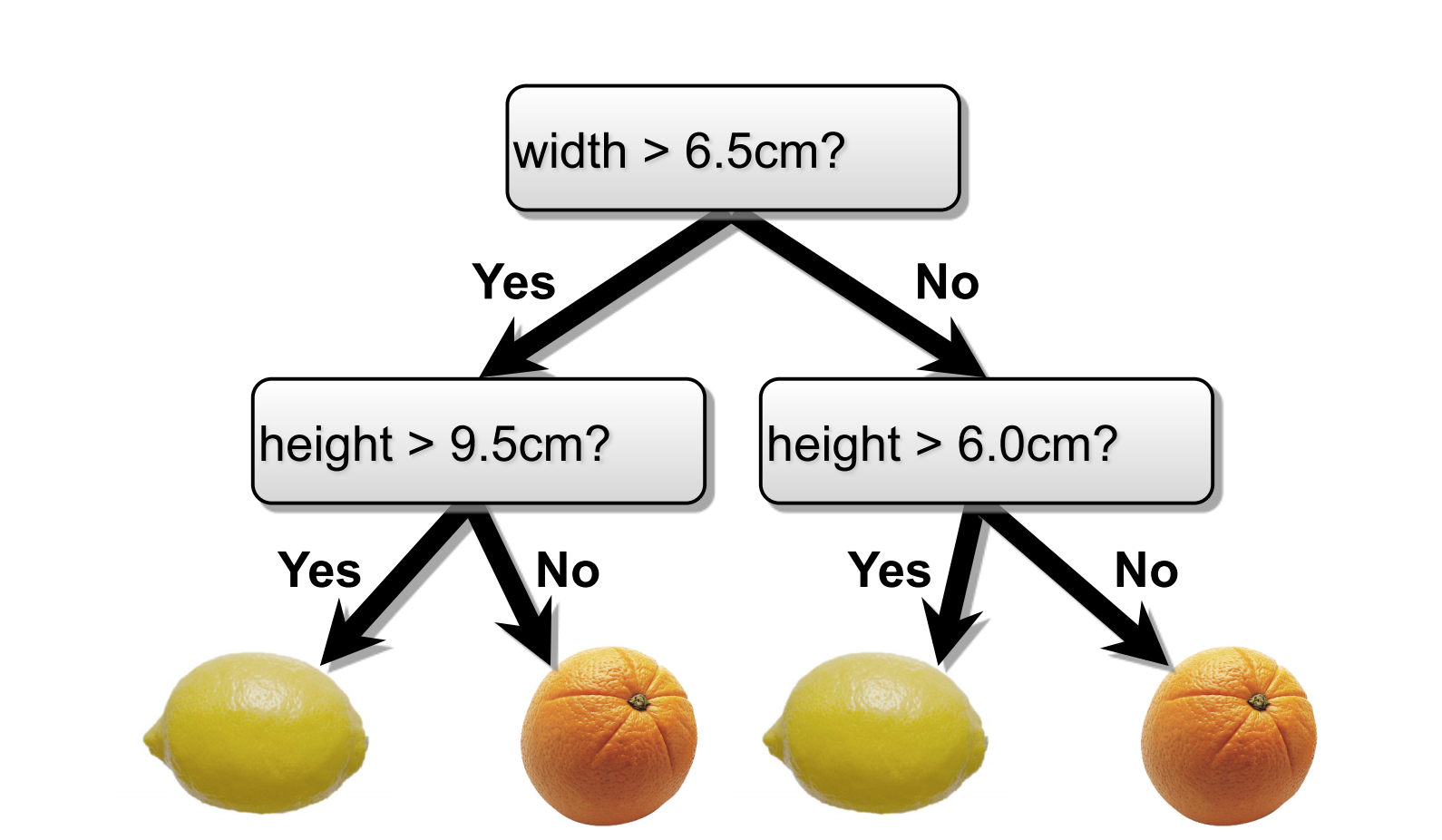
Decision Trees
Algorithm
An attribute for each level that can be labeled true or false
Output at bottom level
Boolean functions can be used to generate a truth table
Classification tree has a discrete output
Regression tree has a continuous output
Regularization is necessary to ensure decision trees are compact

Slide 11
Decision Trees
Creating a tree
Pick the best attribute and split
Repeat at next level
A good decision tree is…
not too small (is accurate)
not too big ( efficiently reaches the solution )

